Slide 1
IMAGE ENHANCEMENT
Neighborhood Pixels Processing

Slide 2
Neighbourhood Operations
Neighbourhood operations simply operate on a larger neighbourhood of pixels than point operations
Neighbourhoods are mostly a rectangle around a central pixel
Any size rectangle and any shape filter are possible
Origin
x
(x, y)
Neighbourhood
y
2
Image f (x, y)
Notes:
2

Slide 3
Local Enhancement through Spatial Filtering
The output intensity value at (x,y) depends not only on the input intensity value at (x,y) but also on the specified number of neighboring intensity values around (x,y)
Spatial masks (also called window, filter, kernel, template) are used and convolved over the entire image for local enhancement (spatial filtering)
The size of the mask determines the number of neighboring pixels which influence the output value at (x,y)
The values (coefficients) of the mask determine the nature and properties of enhancing technique
3

Slide 4
Neighborhood Pixels Processing
It is also spatial domain technique in image enhancement.
Here, we consider one pixel at a time & modify it accordingly.
Its neighboring pixels are also taken in consideration.
So, we change pixel value based on 8 neighbors.
Along with 3x3 neighborhood, 5x5 & 7x7 can also be used.
A lot of things can be achieved by neighborhood processing not possible by point processing.

Slide 5
Simple Neighbourhood Operations Example
Original Image
x
Enhanced Image
x
123
127
128
119
115
130
140
145
148
153
167
172
133
154
183
192
194
191
194
199
207
210
198
195
164
170
175
162
173
151
y
y
5
Notes:
5

Slide 6
The Spatial Filtering Process
Origin
x
a
b
c
r
s
t
d
e
f
*
u
v
w
g
h
i
x
y
z
Original Image Pixels
Filter
Simple 3*3 Neighbourhood
e
3*3 Filter
e_{processed} = v*e + r*a + s*b + t*c + u*d + w*f + x*g + y*h + z*i
y
Image f (x, y)
The above is repeated for every pixel in the original image to generate the smoothed image
Notes:
6

Slide 7
Neighborhood Pixels Processing
To achieve neighborhood processing:
Place the mask on the image.
Multiply each mask component with the pixel component.
Add them, place value at center. Similar to CONVOLUTION.
Only here we need not flip the mask as it is symmetric.
If g is original image & f is modified image, then:
f( x, y) = g(x-1,y-1).w1 + g(x-1,y).w2 + g(x-1,y+1).w3
+ g(x,y-1).w4 + g( x, y).w5 + g(x,y+1).w6
+ g(x+1,y-1).w7 + g(x+1,y).w8 + g(x+1,y+1).w9

Slide 8
Basics of Spatial Filtering
Mask operation near the image border
Problem arises when part of the mask is located outside the
image plane; to handle the problem:
1. Discard the problem pixels (e.g. 512x512input 510x510output, if mask size is 3x3)
2. Zero padding: expand the input image by padding zeros (512x512input 514x514output)
– Zero padding is not good; creates artificial lines or edges on the border
3. Normally, the gray levels of border pixels to fill up the expanded region (for 3x3 mask). For larger masks a border region equal to half of the mask size is mirrored on the expanded region.

Slide 9
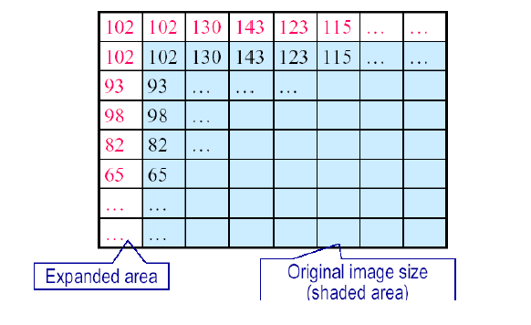
Mask Operation Near the Image Border

Slide 10
Neighborhood Pixels Processing
3 x 3 Neighborhood / Mask / Window / Template:
(y - 1) y (y + 1) Y
(x - 1)
W1 g(x-1, y-1) | W2 g(x-1, y) | W3 g(x-1, y+1)
W4 g(x, y-1) | W5 g(x, y) | W6 g(x, y+1)
W7 g(x+1, y-1) | W8 g(x+1, y) | W9 g(x+1, y+1)
x
(x + 1)
X

Slide 11
Neighborhood Pixels Processing
Once f( x, y) is calculated, shift mask by 1 step to right.
Now, W5 coincide with g(x, y+1).
Application of neighborhood processing : Image Filtering.
E.g. LPF, HPF, BPF, BRF
In 1D signals, if 2 signals represent voltage then,
How fast the signal changes is indication of frequency.
Same concept is applied to images where we have gray levels instead.
If gray scale change slowly over a region then LF area.
E.g. Background
If gray scale change abruptly over a region then HF area.
E.g. Edges, Boundaries.

Slide 12
Frequency Concept - General

Slide 13
Frequency Concept - Image

Slide 14
Neighborhood Pixels Processing
Low Pass Filtering (Smoothing):
Removes HF content from image.
Used to remove noise (HF component) from image.
Noise:
Noise creeps in during image acquisition & transmission.
Noises are classified as:
i) Gaussian Noise
ii) Salt & Pepper Noise
iii) Rayleigh Noise
iv) Gamma Noise
v) Exponential Noise
vi) Uniform Noise

Slide 15
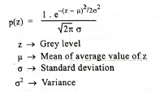
Gaussian Noise

Slide 16
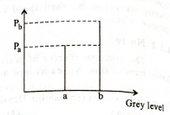
Salt & Pepper Noise

Slide 17
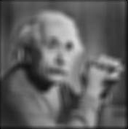
Blurring
In blurring, we simple blur an image.
Blurring can be achieved by many ways. The common type of filters that are used to perform blurring are.
Mean filter
Weighted average filter
Gaussian filter

Slide 18
Mean filter
Mean filter is also known as Box filter and average filter. A mean filter has the following properties.
It must be odd ordered
The sum of all the elements should be 1
All the elements should be same.
If we follow this rule, then for a mask of 3x3. We get the following result.
1/9 | 1/9 | 1/9
1/9 | 1/9 | 1/9
1/9 | 1/9 | 1/9

Slide 19
Size of Mask
The blurring can be increased by increasing the size of the mask. The more is the size of the mask, the more is the blurring. Because with greater mask, greater number of pixels are catered and one smooth transition is defined.

Slide 20
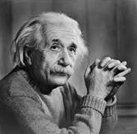

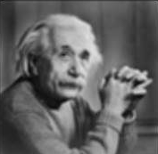
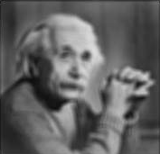
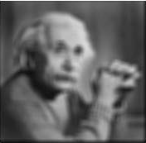
Original Image
3*3 Mask 5*5 Mask 7*7 Mask 9*9 Mask

Slide 21
Illustration of Spatial filtering
7
9
11
0
0
0
0
0
10
50
8
0
7
9
11
0
9
5
6
Original Image
0
10
50
8
0
0
9
5
6
0
1
1
1
1/9
1
1
1
0
0
0
0
0
1
1
1
Input Image after zero padding
3 x 3 Averaging Mask

Slide 22

Movement of Spatial Mask
1/9
1/9
1/9
1/9
1/9
1/9
0
0
0
0
0
1/9
1/9
1/9
1/9
1/9
1/9
0
7
9
11
0
1/9
1/9
1/9
1/9
1/9
1/9
0
10
50
8
0
0
9
5
6
0
0
0
0
0
0
+
+
+
+
+
50 x 1/9
0 x 1/9
0 x 1/9
0 x 1/9
10 x 1/9
+
+
+
0 x 1/9
7 x 1/9
9 x 1/9
0 x 1/9
=
8.4

Slide 23
Movement of Spatial Mask (Cont..)
1/9
1/9
1/9
1/9
1/9
1/9
0
0
0
0
0
1/9
1/9
1/9
1/9
1/9
1/9
0
8.4
9
11
0
1/9
1/9
1/9
1/9
1/9
1/9
0
10
50
8
0
0
9
5
6
0
0
0
0
0
0
+
50 x 1/9
8 x 1/9
+
+
10 x 1/9
0 x 1/9
0 x 1/9
0 x 1/9
+
+
+
+
8.4 x 1/9
9 x 1/9
11 x 1/9
+
=
10.7

Slide 24
Movement of Spatial Mask (Cont..)
1/9
1/9
1/9
1/9
1/9
1/9
0
0
0
0
0
1/9
1/9
1/9
1/9
1/9
1/9
0
8.4
10.7
11
0
1/9
1/9
1/9
1/9
1/9
1/9
0
10
50
8
0
0
9
5
6
0
0
0
0
0
0
+
8 x 1/9
+
0 x 1/9
11 x 1/9
+
50 x 1/9
0 x 1/9
0 x 1/9
0 x 1/9
+
+
+
+
10.7 x 1/9
0 x 1/9
+
=
8.8

Slide 25
Movement of Spatial Mask (Cont..)
1/9
1/9
1/9
0
0
0
0
0
1/9
1/9
1/9
1/9
1/9
1/9
0
8.4
10.7
8.8
0
1/9
1/9
1/9
1/9
1/9
1/9
0
10
50
8
0
1/9
1/9
1/9
0
9
5
6
0
0
0
0
0
0
0 x 1/9
9 x 1/9
+
+
+
+
+
5 x 1/9
10.7 x 1/9
0 x 1/9
10 x 1/9
50 x 1/9
0 x 1/9
8.4 x 1/9
+
+
+
=
10.3

Slide 26
Movement of Spatial Mask (Cont..)
0
0
0
0
0
1/9
1/9
1/9
1/9
1/9
1/9
0
8.4
10.7
8.8
0
1/9
1/9
1/9
1/9
1/9
1/9
0
10.3
50
8
0
1/9
1/9
1/9
1/9
1/9
1/9
0
9
5
6
0
0
0
0
0
0
5 x 1/9
6 x 1/9
9 x 1/9
+
8 x 1/9
+
+
+
10.3 x 1/9
50 x 1/9
+
+
8.4 x 1/9
10.7 x 1/9
8.8 x 1/9
+
+
=
12.9

Slide 27
Movement of Spatial Mask (Cont..)
0
0
0
0
0
1/9
1/9
1/9
1/9
1/9
1/9
0
8.4
10.7
8.8
0
1/9
1/9
1/9
1/9
1/9
1/9
0
10.3
12.9
8
0
1/9
1/9
1/9
1/9
1/9
1/9
0
9
5
6
0
0
0
0
0
0
6 x 1/9
0 x 1/9
5 x 1/9
+
8 x 1/9
0 x 1/9
+
+
+
12.9 x 1/9
+
+
10.7 x 1/9
8.8 x 1/9
0 x 1/9
+
+
=
5.7

Slide 28
Movement of Spatial Mask (Cont..)
0
0
0
0
0
1/9
1/9
1/9
0
8.4
10.7
8.8
0
1/9
1/9
1/9
1/9
1/9
1/9
0
10.3
12.9
5.7
0
1/9
1/9
1/9
1/9
1/9
1/9
0
9
5
6
0
1/9
1/9
1/9
0
0
0
0
0
0x 1/9
0 x 1/9
0 x 1/9
+
9 x 1/9
5 x 1/9
+
+
+
0 x 1/9
+
+
0 x 1/9
10.3 x 1/9
12.9 x 1/9
+
+
=
4.1

Slide 29
Movement of Spatial Mask (Cont..)
0
0
0
0
0
0
8.4
10.7
8.8
0
1/9
1/9
1/9
1/9
1/9
1/9
0
10.3
12.9
5.7
0
1/9
1/9
1/9
1/9
1/9
1/9
0
4.1
5
6
0
1/9
1/9
1/9
1/9
1/9
1/9
0
0
0
0
0
+
5.7x 1/9
12.9 x 1/9
4.1 x 1/9
+
5 x 1/9
+
0 x 1/9
10.3 x 1/9
0 x 1/9
+
+
+
6 x 1/9
0 x 1/9
+
+
=
4.6

Slide 30
Movement of Spatial Mask (Cont..)
0
0
0
0
0
0
8.4
10.7
8.8
0
1/9
1/9
1/9
1/9
1/9
1/9
0
10.3
12.9
5.7
0
1/9
1/9
1/9
1/9
1/9
1/9
0
4.1
4.6
6
0
1/9
1/9
1/9
1/9
1/9
1/9
0
0
0
0
0
+
0 x 1/9
0 x 1/9
5.7 x 1/9
4.6 x 1/9
+
12.9 x 1/9
6 x 1/9
+
0 x 1/9
+
+
+
0 x 1/9
0 x 1/9
+
+
=
3.2

Slide 31
Movement of Spatial Mask (Cont..)
0
0
0
0
0
0
8.4
10.7
8.8
0
0
10.3
12.9
5.7
0
0
4.1
4.6
3.2
0
0
0
0
0
0

Slide 32

Neighborhood Pixels Processing
Low Pass Averaging filter:
Generally used for removal of Gaussian noise from images.
It uses a mask that gives LPF operation.
Important thing: All the coefficients are positive.
Standard LPF Averaging masks:
1 | 1 | 1 | 1
----- | 1 | 1 | 1
9 | 1 | 1 | 1
3 x 3 Averaging Mask

Slide 33
Neighborhood Pixels Processing
 | 1 | 1 | 1 | 1 | 1
1 | 1 | 1 | 1 | 1 | 1
--- | 1 | 1 | 1 | 1 | 1
25 | 1 | 1 | 1 | 1 | 1
 | 1 | 1 | 1 | 1 | 1
5 x 5 Averaging Mask

Slide 34
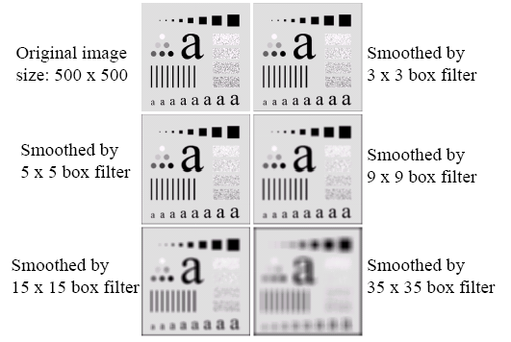
Spatial Filtering for Smoothing (Example)

Slide 35
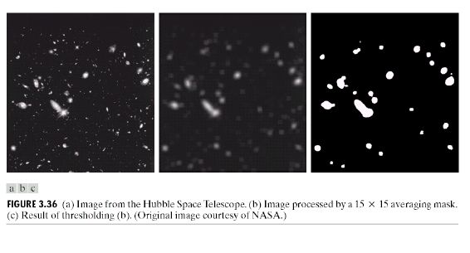
Spatial Filtering for Smoothing (Example)

Slide 36
Weighted Smoothing Filters
More effective smoothing filters can be generated by allowing different pixels in the neighbourhood different weights in the averaging function
Pixels closer to the central pixel are more important
Often referred to as a weighted averaging
¹/₁₆ | ²/₁₆ | ¹/₁₆
²/₁₆ | ⁴/₁₆ | ²/₁₆
¹/₁₆ | ²/₁₆ | ¹/₁₆
Weighted Averaging Filter
Notes:
36

Slide 37
Neighborhood Pixels Processing
Ex. 1) 8x8 Pseudo image with a single edge (High Frequency) of 10 & 50. Remove using a 3x3 size averaging mask.
10 | 10 | 10 | 10 | 10 | 10 | 10 | 10
10 | 10 | 10 | 10 | 10 | 10 | 10 | 10
10 | 10 | 10 | 10 | 10 | 10 | 10 | 10
10 | 10 | 10 | 10 | 10 | 10 | 10 | 10
50 | 50 | 50 | 50 | 50 | 50 | 50 | 50
50 | 50 | 50 | 50 | 50 | 50 | 50 | 50
50 | 50 | 50 | 50 | 50 | 50 | 50 | 50
50 | 50 | 50 | 50 | 50 | 50 | 50 | 50
8x8 Image

Slide 38
Neighborhood Pixels Processing
10 | 10 | 10 | 10 | 10 | 10 | 10 | 10
10 | 10 | 10 | 10 | 10 | 10 | 10 | 10
10 | 10 | 10 | 10 | 10 | 10 | 10 | 10
10 | 10 | 10 | 10 | 10 | 10 | 10 | 10
50 | 50 | 50 | 50 | 50 | 50 | 50 | 50
50 | 50 | 50 | 50 | 50 | 50 | 50 | 50
50 | 50 | 50 | 50 | 50 | 50 | 50 | 50
50 | 50 | 50 | 50 | 50 | 50 | 50 | 50
1
----- 9
1
1
1
1
1
1
1
1
1

Slide 39
Neighborhood Pixels Processing
0 | 0 | 0
0 | 10 | 10 | 10 | 10 | 10 | 10 | 10 | 10
0 | 10 | 10 | 10 | 10 | 10 | 10 | 10 | 10
 | 10 | 10 | 10 | 10 | 10 | 10 | 10 | 10
 | 10 | 10 | 10 | 10 | 10 | 10 | 10 | 10
 | 50 | 50 | 50 | 50 | 50 | 50 | 50 | 50
 | 50 | 50 | 50 | 50 | 50 | 50 | 50 | 50
 | 50 | 50 | 50 | 50 | 50 | 50 | 50 | 50
 | 50 | 50 | 50 | 50 | 50 | 50 | 50 | 50
1
----- 9
1
1
1
1
1
1
1
1
1

Slide 40
Neighborhood Pixels Processing
0 | 0 | 0
0 | 4.44 | 10 | 10 | 10 | 10 | 10 | 10 | 10
0 | 10 | 10 | 10 | 10 | 10 | 10 | 10 | 10
 | 10 | 10 | 10 | 10 | 10 | 10 | 10 | 10
 | 10 | 10 | 10 | 10 | 10 | 10 | 10 | 10
 | 50 | 50 | 50 | 50 | 50 | 50 | 50 | 50
 | 50 | 50 | 50 | 50 | 50 | 50 | 50 | 50
 | 50 | 50 | 50 | 50 | 50 | 50 | 50 | 50
 | 50 | 50 | 50 | 50 | 50 | 50 | 50 | 50
1
----- 9
0
0
0
0
10
10
0
10
10

Slide 41
Neighborhood Pixels Processing
0
0
0
0 | 0 | 0
4.44 | 6.66 | 10 | 10 | 10 | 10 | 10 | 10
10 | 10 | 10 | 10 | 10 | 10 | 10 | 10
10 | 10 | 10 | 10 | 10 | 10 | 10 | 10
10 | 10 | 10 | 10 | 10 | 10 | 10 | 10
50 | 50 | 50 | 50 | 50 | 50 | 50 | 50
50 | 50 | 50 | 50 | 50 | 50 | 50 | 50
50 | 50 | 50 | 50 | 50 | 50 | 50 | 50
50 | 50 | 50 | 50 | 50 | 50 | 50 | 50
1
----- 9
0
10
10
0
0
10 10
10
10

Slide 42
Neighborhood Pixels Processing
0 0
0
0
 | 0 | 0 | 0
4.44 | 6.66 | 6.66 | 10 |  | 10 | 10 | 10 | 10
10 | 10 | 10 | 10 |  | 10 | 10 | 10 | 10
10 | 10 | 10 | 10 |  | 10 | 10 | 10 | 10
10 | 10 | 10 | 10 |  | 10 | 10 | 10 | 10
50 | 50 | 50 | 50 |  | 50 | 50 | 50 | 50
50 | 50 | 50 | 50 |  | 50 | 50 | 50 | 50
50 | 50 | 50 | 50 |  | 50 | 50 | 50 | 50
50 | 50 | 50 | 50 |  | 50 | 50 | 50 | 50
1
----- 9
0
10
10
0
0
10 10
10
10

Slide 43
Neighborhood Pixels Processing
0 0 0
0
0
 |  | 0 | 0 | 0
4.44 | 6.66 | 6.66 | 6.66 | 10 | 10 | 10 | 10
10 | 10 | 10 | 10 | 10 | 10 | 10 | 10
10 | 10 | 10 | 10 | 10 | 10 | 10 | 10
10 | 10 | 10 | 10 | 10 | 10 | 10 | 10
50 | 50 | 50 | 50 | 50 | 50 | 50 | 50
50 | 50 | 50 | 50 | 50 | 50 | 50 | 50
50 | 50 | 50 | 50 | 50 | 50 | 50 | 50
50 | 50 | 50 | 50 | 50 | 50 | 50 | 50
1
----- 9
0
10
10
0
0
10 10
10
10

Slide 44
Neighborhood Pixels Processing
0 0 0 0 0 0 0 0 0
0
0
4.44 | 6.66 | 6.66 | 6.66 | 6.66 | 6.66 | 6.66 | 4.44
6.66 | 10 | 10 | 10 | 10 | 10 | 10 | 10
10 | 10 | 10 | 10 | 10 | 10 | 10 | 10
10 | 10 | 10 | 10 | 10 | 10 | 10 | 10
50 | 50 | 50 | 50 | 50 | 50 | 50 | 50
50 | 50 | 50 | 50 | 50 | 50 | 50 | 50
50 | 50 | 50 | 50 | 50 | 50 | 50 | 50
50 | 50 | 50 | 50 | 50 | 50 | 50 | 50
0
0
1
----- 9
10 10 10
10 10 10
10 10 10

Slide 45
Neighborhood Pixels Processing
0 0 0 0 0 0 0 0 0
 | 4.44 | 6.66 | 6.66 | 6.66 | 6.66 | 6.66 | 6.66 | 4.44
 | 6.66 | 10 | 10 | 10 | 10 | 10 | 10 | 6.66
0 | 6.66 | 10 | 10 | 10 | 10 | 10 | 10 | 6.66
0 | 15.55 | 10 | 10 | 10 | 10 | 10 | 10 | 10
0 | 50 | 50 | 50 | 50 | 50 | 50 | 50 | 50
 | 50 | 50 | 50 | 50 | 50 | 50 | 50 | 50
 | 50 | 50 | 50 | 50 | 50 | 50 | 50 | 50
 | 50 | 50 | 50 | 50 | 50 | 50 | 50 | 50
0
0
0
0
0
0
0
1
----- 9
0
0
0
10
10
50
10
10
50

Slide 46
Neighborhood Pixels Processing
0 | 0 | 0 | 0 | 0 | 0 | 0 | 0 | 0
0 |  |  |  |  |  |  |  |  | 0
0 |  |  |  |  |  |  |  |  | 0
0 |  |  |  |  |  |  |  |  | 0
0 |  |  |  |  |  |  |  |  | 0
0 |  |  |  |  |  |  |  |  | 0
4.44 | 6.66 | 6.66 | 6.66 | 6.66 | 6.66 | 6.66 | 4.44
6.66 | 10 | 10 | 10 | 10 | 10 | 10 | 6.66
6.66 | 10 | 10 | 10 | 10 | 10 | 10 | 6.66
15.55 | 23.3 | 3 10 | 10 | 10 | 10 | 10 | 10
50 | 50 | 50 | 50 | 50 | 50 | 50 | 50
50 | 50 | 50 | 50 | 50 | 50 | 50 | 50
50 | 50 | 50 | 50 | 50 | 50 | 50 | 50
50 | 50 | 50 | 50 | 50 | 50 | 50 | 50
1
----- 9
10
10
50
10
10
50
10
10
50

Slide 47
Neighborhood Pixels Processing
0 | 0 | 0 | 0 | 0 | 0 | 0 | 0 | 0
0 |  |  |  |  |  |  |  |  | 0
0 |  |  |  |  |  |  |  |  | 0
0 |  |  |  |  |  |  |  |  | 0
0 |  |  |  |  |  |  |  |  | 0
0 |  |  |  |  |  |  |  |  | 0
4.44 | 6.66 | 6.66 | 6.66 | 6.66 | 6.66 | 6.66 | 4.44
6.66 | 10 | 10 | 10 | 10 | 10 | 10 | 6.66
6.66 | 10 | 10 | 10 | 10 | 10 | 10 | 6.66
15.55 | 23.3 | 323.3 | 323.33 | 23.33 | 23.33 | 23.33 | 15.55
24.44 | 36.6 | 6 50 | 50 | 50 | 50 | 50 | 50
50 | 50 | 50 | 50 | 50 | 50 | 50 | 50
50 | 50 | 50 | 50 | 50 | 50 | 50 | 50
50 | 50 | 50 | 50 | 50 | 50 | 50 | 50
1
----- 9
10
50
50
10
50
50
10
50
50

Slide 48
Neighborhood Pixels Processing
0 | 0 | 0 | 0 | 0 | 0 | 0 | 0 | 0
0 |  |  |  |  |  |  |  |  | 0
0 |  |  |  |  |  |  |  |  | 0
0 |  |  |  |  |  |  |  |  | 0
0 |  |  |  |  |  |  |  |  | 0
0 |  |  |  |  |  |  |  |  | 0
0
4.44 | 6.66 | 6.66 | 6.66 | 6.66 | 6.66 | 6.66 | 4.44
6.66 | 10 | 10 | 10 | 10 | 10 | 10 | 6.66
6.66 | 10 | 10 | 10 | 10 | 10 | 10 | 6.66
15.5 | 5 23.33 | 23.33 | 23.33 | 23.33 | 23.33 | 23.33 | 15.55
24.4 | 4 36.66 | 36.66 | 36.66 | 36.66 | 36.66 | 36.66 | 24.44
33.3 | 3 50 | 50 | 50 | 50 | 50 | 50 | 50
50 | 50 | 50 | 50 | 50 | 50 | 50 | 50
50 | 50 | 50 | 50 | 50 | 50 | 50 | 50
1
----- 9
50
50
50
50
50
50
50
50
50

Slide 49
Neighborhood Pixels Processing
0 0 0 0 0 0 0 0 0
0 0 0 0 0 0 | 4.44 6.66 6.66 15.55 24.44 33.33 | 6.66 10 10 23.33 36.66 50 | 6.66 10 10 23.33 36.66 50 | 6.66 10 10 23.33 36.66 50 | 6.66 10 10 23.33 36.66 50 | 6.66 10 10 23.33 36.66 50 | 6.66 10 10 23.33 36.66 50 | 4.44 6.66 6.66 15.55 24.44 33.33 | 0 0 0 0 0 0
0 | 33.33 | 50 | 50 | 50 | 50 | 50 | 50 | 33.33 | 0
0 22.22 33.33 33.33 33.33 33.3333.33 33.33 22.22 0
0 0 0 0 0 0 0 0 0
1
----- 9
50
50
0
50
50
0
0
0
0

Slide 50
Neighborhood Pixels Processing
10 | 10 | 10 | 10 | 10 | 10 | 10 | 10
10 | 10 | 10 | 10 | 10 | 10 | 10 | 10
10 | 10 | 10 | 10 | 10 | 10 | 10 | 10
10 | 23.33 | 23.3 | 323.33 | 23.33 | 23.33 | 23.33 | 10
50 | 36.66 | 36.6 | 36.6 | 36.66 | 36.66 | 36.66 | 50
50 | 50 | 50 | 50 | 50 | 50 | 50 | 50
50 | 50 | 50 | 50 | 50 | 50 | 50 | 50
50 | 50 | 50 | 50 | 50 | 50 | 50 | 50
1
----- 9
1
1
1
1
1
1
1
1
1

Slide 51
Neighborhood Pixels Processing
In the resultant image the Low frequency region has remained unchanged.
Sharp transition between 10 & 50 has changed from 10 to
23.33 to 36.66 and finally to 50.
Thus, Sharp edges has become blurred.
Best result when used over image corrupted by Gaussian
noise.
Other types of low pass averaging mask are:
1
---- 6
0
1
0
1
2
1
0
1
0
1
---- 10
1
1
1
1
2
1
1
1
1

Slide 52
Neighborhood Pixels Processing
Low Pass Median Filtering:
Averaging Filter removes the noise by blurring till it is no
longer seen.
It blurs the edges too.
Bigger the averaging mass more the blurring.
Sometimes the image contains ‘salt & pepper noise’.
If averaging filter is used then it will remove the noise at the cost of ruined edges.
Thus a nonlinear filter Median filter is required.
They are also called as order statistics filter since their response is based on ordering or ranking of pixels contained within the mask.
Particularly effective when
– the noise pattern consists of strong, spiky components (impulse noise, salt-and-pepper)
– edges are to be preserved
– Force points with distinct gray levels to be more like their neighbors
➢ Here we use a blank mask.

Slide 53
Neighborhood Pixels Processing
Steps to perform median filtering:
Assume a 3x3 empty mask.
Place the empty mask at the Left Hand corner.
Arrange the 9 pixels in ascending or descending order.
Choose the median from these 9 values.
Place the median at the centre.
Move the mask in same manner as averaging filter.

Slide 54
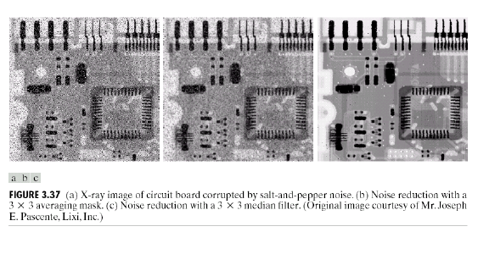
Median Filtering (Example)

Slide 55
Neighborhood Pixels Processing
Apply 3x3 median filter to find a new image.
3 | 4 | 2 | 3
1 | 7 | 3 | 2
4 | 5 | 3 | 8
2 | 3 | 1 | 7
3x3 blank mask
Noisy Image S & P noise

Slide 56
Neighborhood Pixels Processing
Apply 3x3 median filter to find a new image.
3 | 4 | 2 | 3
1 | 7 | 3 | 2
4 | 5 | 3 | 8
2 | 3 | 1 | 7
3 | 4 | 2 | 3
1 | 3 |  | 2
4 |  |  | 8
2 | 3 | 1 | 7
1) 1 2 3 3 3 4 4 5 7

Slide 57
Neighborhood Pixels Processing
Apply 3x3 median filter to find a new image.
3 | 4 | 2 | 3
1 | 7 | 3 | 2
4 | 5 | 3 | 8
2 | 3 | 1 | 7
3 | 4 | 2 | 3
1 | 3 | 3 | 2
4 |  |  | 8
2 | 3 | 1 | 7
1) 1 2 3 3 3 4 4 5 7
2) 2 2 3 3 3 4 5 7 8

Slide 58
Neighborhood Pixels Processing
Apply 3x3 median filter to find a new image.
3 | 4 | 2 | 3
1 | 7 | 3 | 2
4 | 5 | 3 | 8
2 | 3 | 1 | 7
3 | 4 | 2 | 3
1 | 3 | 3 | 2
4 | 3 |  | 8
2 | 3 | 1 | 7
1) 1 2 3 3 3 4 4 5 7
2) 2 2 3 3 3 4 5 7 8
3) 1 1 2 3 3 3 4 5 7

Slide 59
Neighborhood Pixels Processing
Apply 3x3 median filter to find a new image.
3 | 4 | 2 | 3
1 | 7 | 3 | 2
4 | 5 | 3 | 8
2 | 3 | 1 | 7
3 | 4 | 2 | 3
1 | 3 | 3 | 2
4 | 3 | 3 | 8
2 | 3 | 1 | 7
1) 1 | 2 | 3 | 3 | 3 | 4 | 4 | 5 | 7
2) 2 | 2 | 3 | 3 | 3 | 4 | 5 | 7 | 8
3) 1 | 1 | 2 | 3 | 3 | 3 | 4 | 5 | 7
4) 1 | 2 | 3 | 3 | 3 | 5 | 7 | 7 | 8

Slide 60
Neighborhood Pixels Processing
Ex. 2) 8x8 Pseudo image with a single edge (High Frequency) of 10 & 50. Remove using a 3x3 size median filter mask.
10 | 10 | 10 | 10 | 10 | 10 | 10 | 10
10 | 10 | 10 | 10 | 10 | 10 | 10 | 10
10 | 250 | 10 | 10 | 10 | 10 | 10 | 10
10 | 10 | 10 | 10 | 10 | 10 | 10 | 10
50 | 50 | 50 | 50 | 250 | 50 | 50 | 50
50 | 50 | 50 | 50 | 50 | 50 | 50 | 50
50 | 50 | 50 | 50 | 50 | 50 | 50 | 50
50 | 50 | 50 | 50 | 50 | 50 | 50 | 50
8x8 Image

Slide 61
Neighborhood Pixels Processing
10 | 10 | 10 | 10 | 10 | 10 | 10 | 10
10 | 10 | 10 | 10 | 10 | 10 | 10 | 10
10 | 250 | 10 | 10 | 10 | 10 | 10 | 10
10 | 10 | 10 | 10 | 10 | 10 | 10 | 10
50 | 50 | 50 | 50 | 250 | 50 | 50 | 50
50 | 50 | 50 | 50 | 50 | 50 | 50 | 50
50 | 50 | 50 | 50 | 50 | 50 | 50 | 50
50 | 50 | 50 | 50 | 50 | 50 | 50 | 50
8x8 Image with blank mask

Slide 62
Neighborhood Pixels Processing
10 | 10 | 10 | 10 | 10 | 10 | 10 | 10
10 | 10 | 10 | 10 | 10 | 10 | 10 | 10
10 | 250 | 10 | 10 | 10 | 10 | 10 | 10
10 | 10 | 10 | 10 | 10 | 10 | 10 | 10
50 | 50 | 50 | 50 | 250 | 50 | 50 | 50
50 | 50 | 50 | 50 | 50 | 50 | 50 | 50
50 | 50 | 50 | 50 | 50 | 50 | 50 | 50
50 | 50 | 50 | 50 | 50 | 50 | 50 | 50
8x8 Image with blank mask

Slide 63
Neighborhood Pixels Processing
10 | 10 | 10 | 10 | 10 | 10 | 10 | 10
10 | 10 | 10 | 10 | 10 | 10 | 10 | 10
10 | 10 | 10 | 10 | 10 | 10 | 10 | 10
10 | 10 | 10 | 10 | 10 | 10 | 10 | 10
50 | 50 | 50 | 50 | 250 | 50 | 50 | 50
50 | 50 | 50 | 50 | 50 | 50 | 50 | 50
50 | 50 | 50 | 50 | 50 | 50 | 50 | 50
50 | 50 | 50 | 50 | 50 | 50 | 50 | 50
8x8 Image with blank mask
8x8 Image with blank mask

Slide 64
Neighborhood Pixels Processing
10 | 10 | 10 | 10 | 10 | 10 | 10 | 10
10 | 10 | 10 | 10 | 10 | 10 | 10 | 10
10 | 10 | 10 | 10 | 10 | 10 | 10 | 10
10 | 10 | 10 | 10 | 10 | 10 | 10 | 10
50 | 50 | 50 | 50 | 250 | 50 | 50 | 50
50 | 50 | 50 | 50 | 50 | 50 | 50 | 50
50 | 50 | 50 | 50 | 50 | 50 | 50 | 50
50 | 50 | 50 | 50 | 50 | 50 | 50 | 50
8x8 Image with blank mask
8x8 Image with blank mask

Slide 65
Neighborhood Pixels Processing
10 | 10 | 10 | 10 | 10 | 10 | 10 | 10
10 | 10 | 10 | 10 | 10 | 10 | 10 | 10
10 | 10 | 10 | 10 | 10 | 10 | 10 | 10
10 | 10 | 10 | 10 | 10 | 10 | 10 | 10
50 | 50 | 50 | 50 | 250 | 50 | 50 | 50
50 | 50 | 50 | 50 | 50 | 50 | 50 | 50
50 | 50 | 50 | 50 | 50 | 50 | 50 | 50
50 | 50 | 50 | 50 | 50 | 50 | 50 | 50
8x8 Image with blank mask
8x8 Image with blank mask

Slide 66
Neighborhood Pixels Processing
10 | 10 | 10 | 10 | 10 | 10 | 10 | 10
10 | 10 | 10 | 10 | 10 | 10 | 10 | 10
10 | 10 | 10 | 10 | 10 | 10 | 10 | 10
10 | 10 | 10 | 10 | 10 | 10 | 10 | 10
50 | 50 | 50 | 50 | 50 | 50 | 50 | 50
50 | 50 | 50 | 50 | 50 | 50 | 50 | 50
50 | 50 | 50 | 50 | 50 | 50 | 50 | 50
50 | 50 | 50 | 50 | 50 | 50 | 50 | 50
8x8 Image with blank mask
8x8 Image with blank mask

Slide 67
Neighborhood Pixels Processing
Ex 3). Find the median filtered image by 3x3 mask for the given image.
2 | 4 | 15 | 0
3 | 5 | 2 | 6
11 | 0 | 2 | 10
6 | 16 | 0 | 2

Slide 68
Correlation & Convolution
The filtering we have been talking about so far is referred to as correlation with the filter itself referred to as the correlation kernel
Convolution is a similar operation, with just one subtle difference
For symmetric filters it makes no difference
a
b
c
r
s
t
e_{processed} = v*e + z*a + y*b + x*c + w*d + u*e + t*f + s*g + r*h
d
e
e
*
u
v
w
f
g
h
x
y
z
Original Image Pixels
Filter
68
Notes:
68

Slide 69
Neighborhood Pixels Processing
High Pass Filtering:
Retains HF component while eliminates LF components.
High passed image will have no background(Low freq region).
It will have enhanced edges.
Used to sharpen blurred images.
Process of mask moving on image is same only the mask
coefficients change.
Mask coefficients should have positive value at centre and negative values elsewhere.
Sum of coefficients must be zero.
Since, it should give Zero after being placed on LP region.

Slide 70
Neighborhood Pixels Processing
High Pass Masks:
3x3 High pass masks
-1 | -1 | -1
-1 | 8 | -1
-1 | -1 | -1
0 | -1 | 0
-1 | 4 | -1
0 | -1 | 0
-1 | -2 | -1
-2 | 12 | -2
-1 | -2 | -1

Slide 71
Neighborhood Pixels Processing
Ex 4) 8x8 Pseudo image with a single edge (High Frequency) of 10 & 100. Remove LP using a 3x3 size High pass filter mask.
10 | 10 | 10 | 10 | 10 | 10 | 10 | 10
10 | 10 | 10 | 10 | 10 | 10 | 10 | 10
10 | 10 | 10 | 10 | 10 | 10 | 10 | 10
10 | 10 | 10 | 10 | 10 | 10 | 10 | 10
100 | 100 | 100 | 100 | 100 | 100 | 100 | 100
100 | 100 | 100 | 100 | 100 | 100 | 100 | 100
100 | 100 | 100 | 100 | 100 | 100 | 100 | 100
100 | 100 | 100 | 100 | 100 | 100 | 100 | 100

Slide 72
Neighborhood Pixels Processing
10 | 10 | 10 | 10 | 10 | 10 | 10 | 10
10 | 10 | 10 | 10 | 10 | 10 | 10 | 10
10 | 10 | 10 | 10 | 10 | 10 | 10 | 10
10 | 10 | 10 | 10 | 10 | 10 | 10 | 10
100 | 100 | 100 | 100 | 100 | 100 | 100 | 100
100 | 100 | 100 | 100 | 100 | 100 | 100 | 100
100 | 100 | 100 | 100 | 100 | 100 | 100 | 100
100 | 100 | 100 | 100 | 100 | 100 | 100 | 100
-1 | -1 | -1
-1 | 8 | -1
-1 | -1 | -1
-10-10-10-10-10-10-10-10+80 = 0

Slide 73
Neighborhood Pixels Processing
10 | 10 | 10 | 10 | 10 | 10 | 10 | 10
10 | 10 | 10 | 10 | 10 | 10 | 10 | 10
10 | 10 | 10 | 10 | 10 | 10 | 10 | 10
10 | 10 | 10 | 10 | 10 | 10 | 10 | 10
100 | 100 | 100 | 100 | 100 | 100 | 100 | 100
100 | 100 | 100 | 100 | 100 | 100 | 100 | 100
100 | 100 | 100 | 100 | 100 | 100 | 100 | 100
100 | 100 | 100 | 100 | 100 | 100 | 100 | 100
-1 | -1 | -1
-1 | 8 | -1
-1 | -1 | -1
-10-10-10-10-10-10-10-10+80 = 0

Slide 74
Neighborhood Pixels Processing
10 | 10 | 10 | 10 | 10 | 10 | 10 | 10
10 | 10 | 10 | 10 | 10 | 10 | 10 | 10
10 | 10 | 10 | 10 | 10 | 10 | 10 | 10
10 | 10 | 10 | 10 | 10 | 10 | 10 | 10
100 | 100 | 100 | 100 | 100 | 100 | 100 | 100
100 | 100 | 100 | 100 | 100 | 100 | 100 | 100
100 | 100 | 100 | 100 | 100 | 100 | 100 | 100
100 | 100 | 100 | 100 | 100 | 100 | 100 | 100
-1 | -1 | -1
-1 | 8 | -1
-1 | -1 | -1
-10-10-10-10-10-100-100-100+80 = -270

Slide 75
Neighborhood Pixels Processing
10 | 10 | 10 | 10 | 10 | 10 | 10 | 10
10 | 10 | 10 | 10 | 10 | 10 | 10 | 10
10 | 10 | 10 | 10 | 10 | 10 | 10 | 10
10 | 10 | 10 | 10 | 10 | 10 | 10 | 10
100 | 100 | 100 | 100 | 100 | 100 | 100 | 100
100 | 100 | 100 | 100 | 100 | 100 | 100 | 100
100 | 100 | 100 | 100 | 100 | 100 | 100 | 100
100 | 100 | 100 | 100 | 100 | 100 | 100 | 100
-1 | -1 | -1
-1 | 8 | -1
-1 | -1 | -1
-10-10-10-100-100-100-100-100+800 = +270

Slide 76
Neighborhood Pixels Processing
10 | 10 | 10 | 10 | 10 | 10 | 10 | 10
10 | 10 | 10 | 10 | 10 | 10 | 10 | 10
10 | 10 | 10 | 10 | 10 | 10 | 10 | 10
10 | 10 | 10 | 10 | 10 | 10 | 10 | 10
100 | 100 | 100 | 100 | 100 | 100 | 100 | 100
100 | 100 | 100 | 100 | 100 | 100 | 100 | 100
100 | 100 | 100 | 100 | 100 | 100 | 100 | 100
100 | 100 | 100 | 100 | 100 | 100 | 100 | 100
-1 | -1 | -1
-1 | 8 | -1
-1 | -1 | -1
-100-100-100-100-100-100-100-100+800 = 0

Slide 77
Neighborhood Pixels Processing
0 | 0 | 0 | 0 | 0 | 0 | 0 | 0
0 | 0 | 0 | 0 | 0 | 0 | 0 | 0
0 | 0 | 0 | 0 | 0 | 0 | 0 | 0
-270 | -270 | -270 | -270 | -270 | -270 | -270 | -270
270 | 270 | 270 | 270 | 270 | 270 | 270 | 270
0 | 0 | 0 | 0 | 0 | 0 | 0 | 0
0 | 0 | 0 | 0 | 0 | 0 | 0 | 0
0 | 0 | 0 | 0 | 0 | 0 | 0 | 0
Note:
-270 is replaced by 0.
270 is replaced by 255

Slide 78
High-Boost Filtering
There are times when we want to enhance the images without loosing background.
In High-Boost filters we pass some of the background alongwith high frequency content.
We know that,
High Pass = Original – Low Pass
To pass some of the background, we multiply the original image with a multiplicative factor A. This gives us High-Boost Filtering.

Slide 79
High-Boost Filtering
We know that,
High Pass = Original – Low Pass
To pass some of the background, we multiply the original image with a multiplicative factor A. This gives us High-Boost Filtering.
High-Boost = A*Original – Low Pass
= (A-1) *Original +Original – Low Pass
= (A-1) *Original + High Pass
If A = 1, then
High-Boost = High Pass
If A > 1, then
Some original signal is added back to the high pass result. Thus some of the background is restored in high passed image.
This technique is also known as Unsharp Masking.

Slide 80

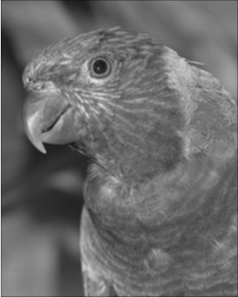

Spatial Averaging
3 x 3 Smoothing filter
Original Image
Smoothened Image

Slide 81


Spatial Averaging
5 x 5 Smoothing filter
Original Image
Smoothened Image

Slide 82

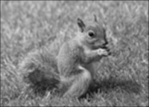
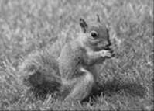
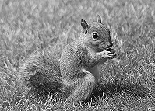
Average Vs Weighted Average
Original Image

Slide 83

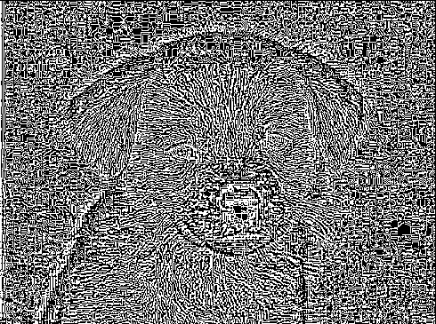
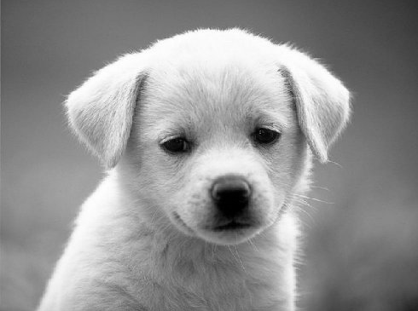
Image Sharpening
Original Image
Edge Enhanced Image

